Slide 1
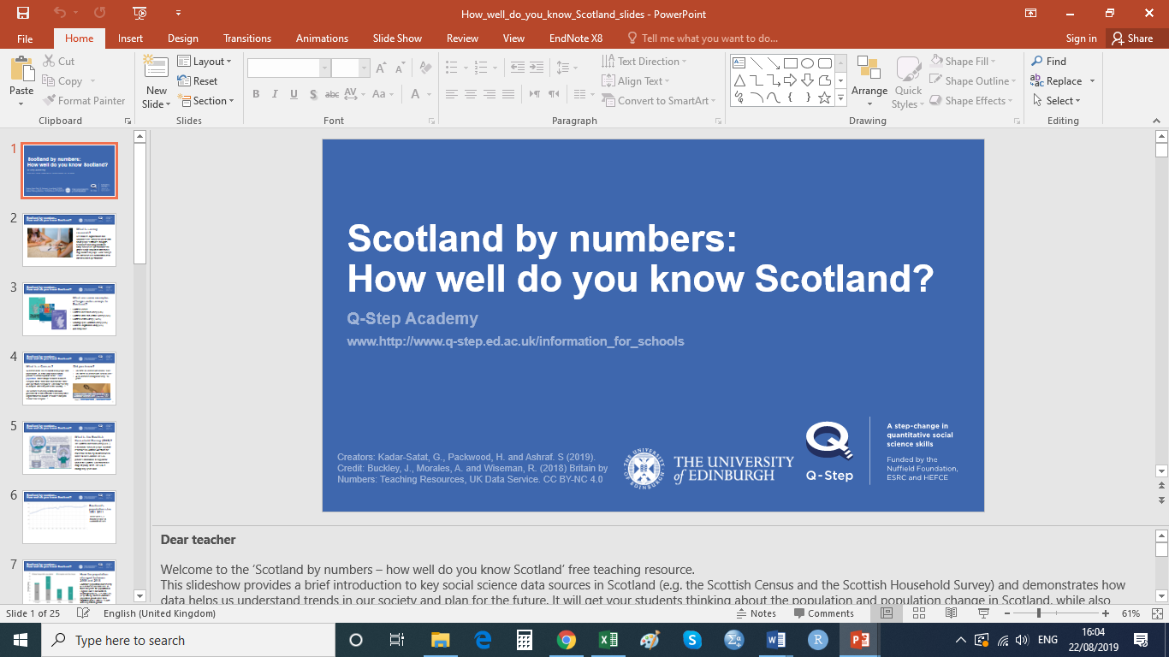

Scotland by numbers:
A Picture of Crime Scotland
Q-Step Academy
QUIZ with Answers
Creators: Kadar-Satat, G., Packwood, H. and Ashraf. S (2019). Credit: Buckley, J., Morales, A. and Wiseman, R. (2018) Britain by Numbers: Teaching Resources, UK Data Service. CC BY-NC 4.0

Slide 2
A Picture of Crime Scotland? Quiz!
Name:____________________________________________________________
Data sources on crime in Scotland | 1. The Edinburgh Study of Youth Transitions & Crime is a longitudinal cohort study. Data for this study is collected (a) Repeatedly, from the same individuals each time (b) Repeatedly, from different individuals each time 2. Which of these statements about the Scottish Crime and Justice Survey (SCJS) is FALSE? (a) It collects data on adults experience of crime (b) It collects data on adults perceptions of crime and safety (c) It collects data every 10 years
Change in crime rates | 3. What happened to the general level of crime in Scotland between 2008 & 2018? (a) An increase in general levels of crime (b) A decline in general levels of crime (c) No change in general levels of crime
Experience of crime | 4. The percentage of adults in Scotland who didn’t experience any crime is: (a) 87.5% (b) 77.5% (c) 67.5% (d) 57.5% 5. The most common property crime reported in the 2017/18 SCJS was: (a) Household theft (b) Housebreaking (c) Motor theft (d) Vandalism 6. Which age group is least likely to experience violent crime? (a) 16-24 year-olds (b) 25-44 year-olds (c) 45-59 year-olds (d) People aged 60+
Young people and crime | 7. The percentage of 17-year-olds in Edinburgh saying they had ‘ever’ carried some kind of weapon for self protection is: (a) 25% (b)18% (c) 9% (d) 2%

Slide 3

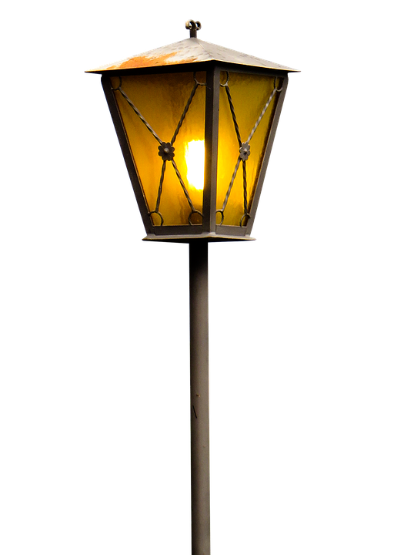
A Picture of Crime Scotland? Quiz!
Young people and crime | 8. The figure below shows the % of knife carriers and non-knife carriers who were involved in different types of anti-social behaviours when they were 16. What should be the label of the dark blue bars? (a) Non-knife carriers (b) Knife carriers (c) Type of knife
Views of the police | 9. What percentage of adults are confident in the ability of the police to solve crimes? (a) 95% in urban areas and 91% in rural areas (b) 95% in rural areas and 91% in urban areas (c) 65% in urban areas and 61% in rural areas (d) 65% in rural areas and 61% in urban areas 10. Are the majority of adults in Scotland confident or not confident in the fairness of the police? Confident (b) Not-confident
Fear of Crime | 11. Which type pf crime adults are most worried about being victims of? (a) Fraud (b) Robbery (c) Minor assault (d) Serious assault 12. Which of these groups is more likely to feel unsafe walking alone in their local area after dark? (a) Men (b) Women (c) Equally men and women

Slide 4
What is the Q Step Academy?
The Q Step Academy is a partnership between the Edinburgh Q Step Centre and schools in Edinburgh and the city region. This partnership will provide free training and resources on statistical literacy for staff and pupils in the Social Sciences.
What will the Academy do?
The Q-Step Academy aims to raise the profile of social statistics and data literacy within schools. It will work in collaboration with teachers, delivering masterclass sessions to pupils and creating resources which link to the curriculum.
How can your school get involved?
We are looking to develop links with schools in the future, if you would like more information, please get in touch by emailing us: qstepacademy@ed.ac.uk or visit: www.q-step.ed.ac.uk
About the creators of this resource:
Dr Gitit Kadar-Satat
Outreach Fellow, University of Edinburgh Q-Step Centre.
Dr Helen Packwood Outreach Fellow, University of Edinburgh Q-Step Centre.
Mr Sohaib Ashraf is studying MA Politics with Quantitative Methods.

