Slide 1

Scotland by numbers: A Picture of Crime – Using Statistics to Understand Crime in Scotland
Q-Step Academy
Creators: Kadar-Satat, G., Packwood, H. and Ashraf. S (2019). Credit: Buckley, J., Morales, A. and Wiseman, R. (2018) Britain by Numbers: Teaching Resources, UK Data Service. CC BY-NC 4.0
Notes:
Dear teacher
Welcome to the ‘Scotland by Numbers: A Picture of Crime – Using Data to Understand Crime in Scotland’ free teaching resource.
This slideshow provides a brief introduction to key crime statistics sources in Scotland and demonstrates how data helps us understand trends in crime. It will get your students thinking about crime in Scotland, while also developing an understanding of social research methods and ways of presenting data, for example in charts, graphs, and percentages.
Teacher’s ‘notes’ are included below each slide and provide links, fun facts, ideas for group discussions, and optional class or take home activities. There are also links to videos, but these are optional, so there’s no need to arrange special IT equipment or connection to the internet in order to use this slideshow effectively. Please feel free to use this material as you see fit, including editing the content or using only parts of the slideshow.
Please note that there is also a related quiz on our website, which consolidates and assesses the learning process. The questions in this quiz cover a wide range of themes including trends and types of crime, youth and crime, and public perceptions of crime and safety. It takes about 10 minutes to complete this quiz. We also included an answers sheet, for your convenience. If you have any questions or comment about this resource, please contact us by emailing: qstepacademy@ed.ac.uk.
Happy teaching!

Slide 2


Scotland by numbers: A Picture of Crime
What are some sources of crime statistics in Scotland?
Police Records
Scottish Household Survey (SHS)
Scottish Crime and Justice Survey (SCJS)
Edinburgh Study of Youth Transitions and Crime (ESYTC)
Understanding Glasgow – the Glasgow Indicators Project
And more…
Notes:
TEACHER NOTES
Optional take-home activity
In pairs or small groups, explore one of the following surveys using the internet.
Scottish Health Survey (SHeS)
Edinburgh Study of Youth Transitions and Crime
Understanding Glasgow – the Glasgow Indicators Project
Prepare a short report or a presentation covering the following questions:
What are the aims of the survey?
When was the survey launched and, since then, how many times it has been administered ?
Who are the participants in this survey (how many? what age groups? Where are they from?)
What are some of the questions being asked in this survey?
What are some findings from this survey?

Slide 3

Scotland by numbers: A Picture of Crime
What is the Scottish Crime and Justice Survey (SCJS)?
‘The SCJS is a large-scale social survey which asks people about their experiences and perceptions of crime. The SCJS is important because it provides a picture of crime in Scotland, including crimes that haven’t been reported to, or recorded by the police...’
The survey is being held every two years. In 2017/18, 5,475 people were surveyed in the SCJS.
Findings from the SCJS help policy makers in understanding the nature of crime in Scotland, targeting resources & monitoring the impact of initiatives to target crime.
Source: https://www2.gov.scot/Topics/Statistics/Browse/Crime-Justice/crime-and-justice-survey
Notes:
TEACHER NOTES
Source: https://www2.gov.scot/Topics/Statistics/Browse/Crime-Justice/crime-and-justice-survey

Slide 4


Scotland by numbers: A Picture of Crime
What is the Edinburgh Study of Youth Transitions & Crime (ESYTC)?
The ESYTC is a longitudinal cohort study, which means that it surveys the same people repeatedly over a long period of time. This study design helps researchers and policy makers to identify what leads to offending behaviour and desistance from it.
Source: https://www.esytc.ed.ac.uk/
.
The Edinburgh Study of Youth Transitions and Crime (ESYTC) is a research project focusing on the causes of criminal and risky behaviours in young people. The project follows the lives of 4,317 young people who started secondary school in Edinburgh in 1998.
Watch: a brief introduction to the ESYTC, Prof Lesley McAra (1:19 min)
Notes:
TEACHER NOTES
Did you know:
The Edinburgh Study of Youth Transitions & Crime is managed by the University of Edinburgh Law School
Ideas for discussion:
The study surveyed a sample of young people in Edinburgh. In your opinion, what are the pros and cons of sampling only in Edinburgh?
And, what are the pros and cons of conducting a longitudinal cohort study?
Video: https://media.ed.ac.uk/media/1_5uv4o62d

Slide 5
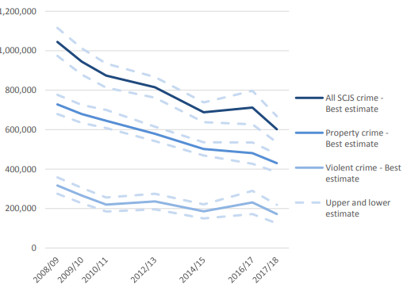
Scotland by numbers: A Picture of Crime
How much crime was there?
The total number of offences is estimated to have fallen from just over 1 million in 2008/9 to about 600,000 in 2017/18. This change represents a decrease of 42% in the rate of crime experienced in Scotland.
While the rate of violent crime remained relatively stable between 2010 and 2018, the rate of property crime has fallen significantly.
Source: Scottish Government (2018). Scottish Crime and Justice Survey 2017/18: Main Findings. https://bit.ly/33WpWTf
Notes:
TEACHER NOTES
Ideas for discussion:
What can explain the drop in crime rate between 2008 and 2018?
Source: Scottish Government (2018). Scottish Crime and Justice Survey 2017/18: Main Findings. https://www.gov.scot/binaries/content/documents/govscot/publications/statistics/2019/03/scottish-crime-justice-survey-2017-18-main-findings/documents/scottish-crime-justice-survey-2017-18-main-findings/scottish-crime-justice-survey-2017-18-main-findings/govscot%3Adocument/scottish-crime-justice-survey-2017-18-main-findings.pdf (accessed 20 August 2019)

Slide 6
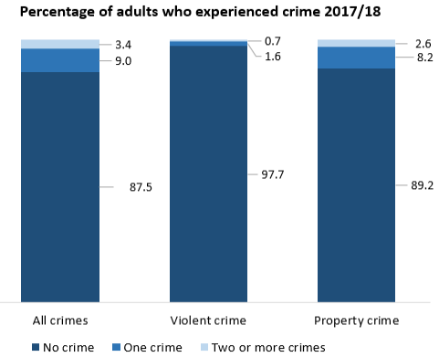
Scotland by numbers: A Picture of Crime
How many people experience crime?
Most adults in Scotland (87%) did not experience crime in 2017/18.
Violent crime was experienced by 2.3% of adults in Scotland in 2017/18 while 10.8% experienced property crime.
Source: adapted from Scottish Government (2018). Scottish Crime and Justice Survey 2017/18: Main Findings. https://bit.ly/33WpWTf
Notes:
TEACHER NOTES

Slide 7
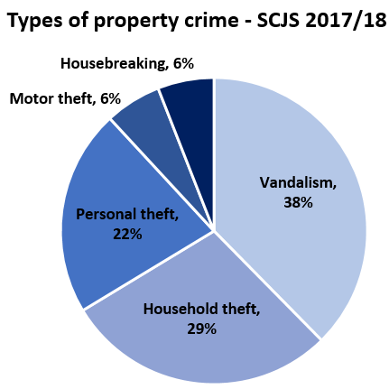
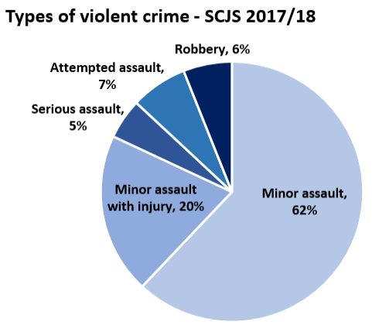
Scotland by numbers: A Picture of Crime
What is violent and property crime?
Source: adapted from Scottish Government (2018). Scottish Crime and Justice Survey 2017/18: Main Findings. https://bit.ly/33WpWTf
Notes:
TEACHER NOTES
Did you know:
Only 39% of violent offences were reported to the police in 2017/18
Only 34% of property crimes were reported to the police in 2017/18
Ideas for discussion:
What could be the reasons for some crimes not being reported to the police?
In your opinion, are some people more likely to report crime to the police than others?

Slide 8
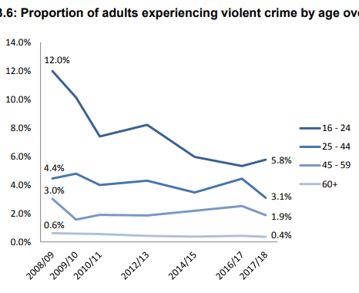
Scotland by numbers: A Picture of Crime
Violent crime in Scotland
Young adults (aged 16-24) are more likely to experience violent crime than any other age group. However, the rate of violent crime experienced by young adults has fallen from 12% to 5.8% between 2008/9 and 2017/18.
Source: Scottish Government (2018). Scottish Crime and Justice Survey 2017/18: Main Findings. https://bit.ly/33WpWTf
Notes:
TEACHER NOTES
Ideas for discussion:
In your opinion, why are young adults more likely to experience violent crime than any other age group?
Source: Scottish Government (2018). Scottish Crime and Justice Survey 2017/18: Main Findings. https://bit.ly/33WpWTf (accessed 12th August 2019)

Slide 9
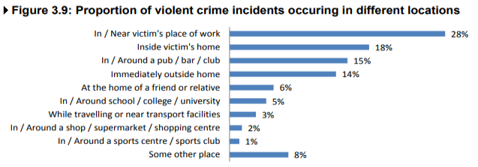
Scotland by numbers: A Picture of Crime
Violent crime in Scotland
The majority of violent crime took place in public settings in 2017/18. However, 18% of incidents occurred in the victim’s home and 14% immediately outside the home.
Source: Scottish Government (2018). Scottish Crime and Justice Survey 2017/18: Main Findings. https://bit.ly/33WpWTf
Notes:
TEACHER NOTES
Ideas for discussion:
In your opinion, why are young adults more likely to experience violent crime than any other age group?
Source: Scottish Government (2018). Scottish Crime and Justice Survey 2017/18: Main Findings. https://bit.ly/33WpWTf (accessed 12th August 2019)

Slide 10
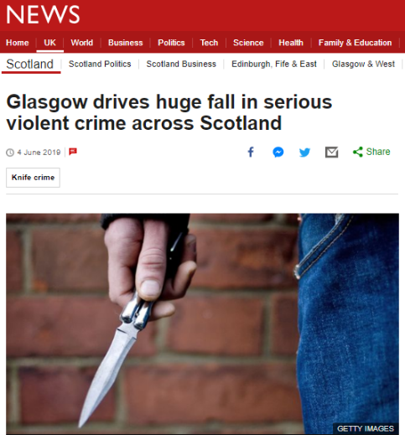

Scotland by numbers: A Picture of Crime
Violent crime in Scotland
‘Falling levels of serious violent crime in the west of Scotland have driven a reduction across the country over the past decade, a study has concluded.
The analysis said serious assault and attempted murder cases fell by 35% in Scotland between 2008-09 and 2017-18. The study said 89% of that drop was due to fewer cases in the west, particularly in and around Glasgow.’
Source: https://www.bbc.co.uk/news/uk-scotland-48512477
Watch: tackling violent crime in Scotland, Mr Will Linden (1:01 min)
Notes:
TEACHER NOTES
Source: https://www.bbc.co.uk/news/uk-scotland-48512477

Slide 11
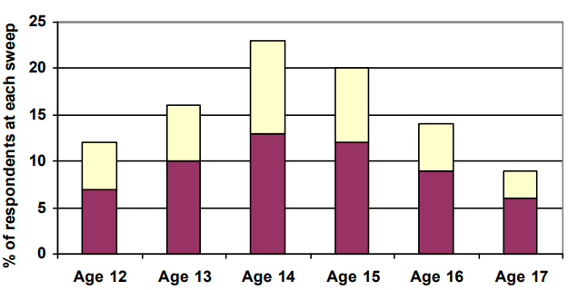


Scotland by numbers: A Picture of Crime
Percentage of young people who said they had carried a knife or other type of weapon, by age (ESYTC).
Young people and crime
The Edinburgh Study of Youth Transitions and Crime asked young people in Edinburgh if they had carried a knife or other weapon for protection or in case it was needed.
The study found that among 12-year-olds, 12% said they had ‘ever’ carried some kind of weapon. The peak age at which weapon carrying was reported was age 14, at which point 23% of young people said they had done this in the last year.’
Source: McVie, S 2010, Gang Membership and Knife Carrying: Findings from the Edinburgh Study of Youth Transitions and Crime. https://bit.ly/30BGttS
Notes:
TEACHER NOTES
Source: McVie, S 2010, Gang Membership and Knife Carrying: Findings from the Edinburgh Study of Youth Transitions and Crime. Scottish Government Social Research. https://www.research.ed.ac.uk/portal/files/237487/SMcVie.pdf (accessed 12th August 2019)

Slide 12
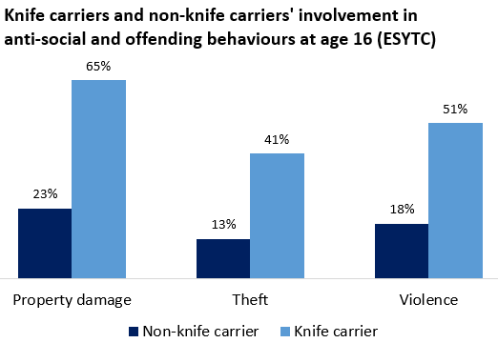

Scotland by numbers: A Picture of Crime
Young people and crime
The Edinburgh Study of Youth Transitions and Crime shows that, at age 16 knife carriers are more likely to get involved in anti-social and offending behaviours. For example, 65% of knife carriers reported being involved in property damage compared to 23% of non-knife carriers.
Source: adapted from McVie, S 2010, Gang Membership and Knife Carrying: Findings from the Edinburgh Study of Youth Transitions and Crime. https://bit.ly/30BGttS
Watch: research underpins new minimum age of criminal responsibility in Scotland, Prof Susan McVie & Prof Lesley McAra (3:32 min)
Notes:
TEACHER NOTES
Source: adapted from McVie, S 2010, Gang Membership and Knife Carrying: Findings from the Edinburgh Study of Youth Transitions and Crime. Scottish Government Social Research. https://www.research.ed.ac.uk/portal/files/237487/SMcVie.pdf
Video: https://www.youtube.com/watch?v=BxcFkfXt5nw

Slide 13
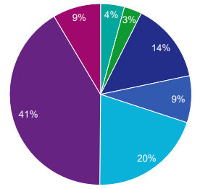
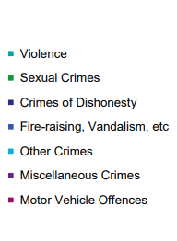
Scotland by numbers: A Picture of Crime
Overview of Cases for Young People Reported to COPFS in 2016/17, by type of crime
Young people and crime
There were 7,539 cases involving 8,043 young people (age 12 to 17 inclusive) reported to the Crown Office and Procurator Fiscal Service (COPFS) in in 2016/17. Miscellaneous crimes accounted for 41% of al cases. This category includes offences of public disorder, assaults, stalking and a wide range of low-level offences.
Source: Scottish Government (2018). Prosecution of young people: report. https://www.gov.scot/publications/thematic-report-prosecution-young-people/
Notes:
TEACHER NOTES
Source: Scottish Government (2018). Prosecution of young people: report
https://www.gov.scot/publications/thematic-report-prosecution-young-people/ (accessed 15th August 2019)

Slide 14
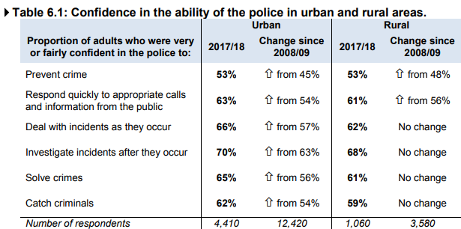
Scotland by numbers: How well do you know Scotland?
Views of the police
Just over half of adults in Scotland are confident in the ability of the police to prevent crime. Overall, the level of confidence in the police has increased between 2008/9 and 2017/18, especially in urban areas.
Source: Scottish Government (2018). Scottish Crime and Justice Survey 2017/18: Main Findings. https://bit.ly/33WpWTf
Notes:
TEACHER NOTES
Source: Scottish Government (2018). Scottish Crime and Justice Survey 2017/18: Main Findings. https://www.gov.scot/binaries/content/documents/govscot/publications/statistics/2019/03/scottish-crime-justice-survey-2017-18-main-findings/documents/scottish-crime-justice-survey-2017-18-main-findings/scottish-crime-justice-survey-2017-18-main-findings/govscot%3Adocument/scottish-crime-justice-survey-2017-18-main-findings.pdf [Accessed 22nd August 2019].

Slide 15
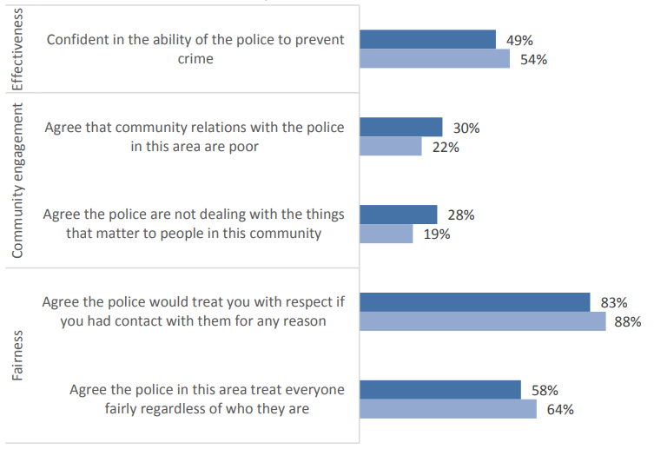
Scotland by numbers: How well do you know Scotland?
Variation in perceptions of the police by deprivation
Views of the police
People living in the most deprived areas of Scotland perceive the police as less effective, engaged and fair than people who live in less deprived or non deprived areas.
Source: Scottish Government (2018). Scottish Crime and Justice Survey 2017/18: Main Findings. https://bit.ly/33WpWTf
Notes:
TEACHER NOTES
Source: Scottish Government (2018). Scottish Crime and Justice Survey 2017/18: Main Findings. https://www.gov.scot/binaries/content/documents/govscot/publications/statistics/2019/03/scottish-crime-justice-survey-2017-18-main-findings/documents/scottish-crime-justice-survey-2017-18-main-findings/scottish-crime-justice-survey-2017-18-main-findings/govscot%3Adocument/scottish-crime-justice-survey-2017-18-main-findings.pdf [Accessed 22nd August 2019].

Slide 16
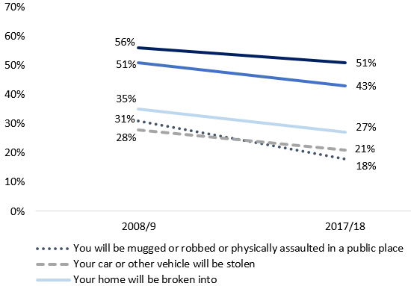
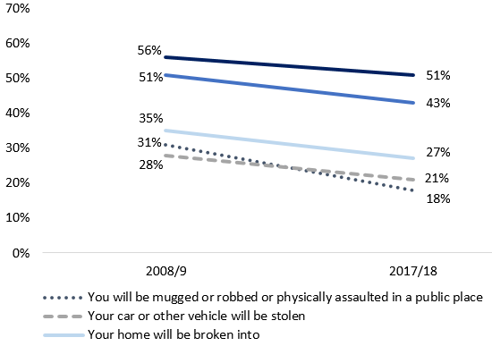


Scotland by numbers: How well do you know Scotland?
Proportion of adults who were worried about experiencing different types of crime, 2008/09 – 2017/18
Fear of crime
Overall, in 2017/18, people in Scotland were less worried about experiencing crime than they were in 2008/9. About half of the survey respondents said they are worried about being a victim of online fraud and 43% said they are worried about identity theft, both are examples of cybercrime.
Source: adapted from Scottish Government (2018). Scottish Crime and Justice Survey 2017/18: Main Findings. https://bit.ly/33WpWTf
Notes:
TEACHER NOTES
Source: Scottish Government (2018). Scottish Crime and Justice Survey 2017/18: Main Findings. https://www.gov.scot/binaries/content/documents/govscot/publications/statistics/2019/03/scottish-crime-justice-survey-2017-18-main-findings/documents/scottish-crime-justice-survey-2017-18-main-findings/scottish-crime-justice-survey-2017-18-main-findings/govscot%3Adocument/scottish-crime-justice-survey-2017-18-main-findings.pdf [Accessed 22nd August 2019].

Slide 17
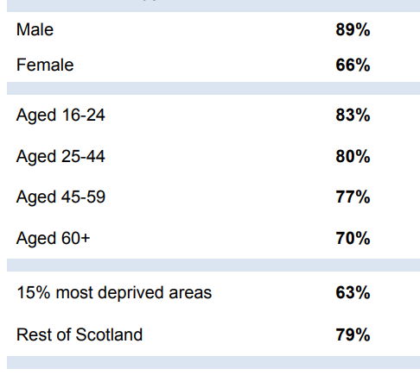
Scotland by numbers: How well do you know Scotland?
Proportion of adults who felt safe/unsafe walking alone in the local area after dark (SCJS 2017/18)
Fear of crime
Men, young adults and people living in non-deprived areas are more likely to feel safe walking alone after dark than women, older people and those living in the most deprived areas of Scotland.
Source: Scottish Government (2018). Scottish Crime and Justice Survey 2017/18: Main Findings. https://bit.ly/33WpWTf
Notes:
TEACHER NOTES
Image source: Scottish Government (2018). Scottish Crime and Justice Survey 2017/18: Main Findings. https://www.gov.scot/binaries/content/documents/govscot/publications/statistics/2019/03/scottish-crime-justice-survey-2017-18-main-findings/documents/scottish-crime-justice-survey-2017-18-main-findings/scottish-crime-justice-survey-2017-18-main-findings/govscot%3Adocument/scottish-crime-justice-survey-2017-18-main-findings.pdf [Accessed 22nd August 2019].

Slide 18

What is the Q Step Academy? The Q Step Academy is a partnership between the Edinburgh Q Step Centre and schools in Edinburgh and the city region. This partnership will provide free training and resources on statistical literacy for staff and pupils in the Social Sciences. What will the Academy do? The Q-Step Academy aims to raise the profile of social statistics and data literacy within schools. It will work in collaboration with teachers, delivering masterclass sessions to pupils and creating resources which link to the curriculum. How can your school get involved? We are looking to develop links with schools in the future, if you would like more information, please get in touch by emailing us: qstepacademy@ed.ac.uk or visit: www.q-step.ed.ac.uk
About the creators of this resource:
Dr Gitit Kadar-Satat
Outreach Fellow, University of Edinburgh Q-Step Centre.
Dr Helen Packwood Outreach Fellow, University of Edinburgh Q-Step Centre.
Mr Sohaib Ashraf is studying MA Politics with Quantitative Methods.

